Slide 1
Batch Processing
Spring Cloud Data Flow

Slide 2
Spring Cloud Data Flow
re-brand from Spring XD to Spring Cloud Data Flow
This new product uses executable applications as the foundation for modules, and focuses on the orchestration of them.
the redesign allows stream and batch applications to run as data Microservices that can be independently evolved.

Slide 3
What is it?
Spring Cloud Data Flow is a toolkit for building data integration and real-time data processing pipelines.
Pipelines consist of Spring Boot apps, built using the
Spring Cloud Stream or Spring Cloud Task Microservice frameworks that are part of the Spring Cloud Data Flow Project.
suitable for a range of data processing use cases, from import/export to event streaming and predictive analytics.
Stream and batch applications to run as data Microservices

Slide 4
Architecture
Each Spring Cloud Data Flow stream or task is actually a distributed application (Spring Boot based microservice that runs in a different process) and are bound together via message brokers. That is why either RabbitMQ or Kafka needs to be installed.

Slide 5
Spring Cloud Data Flow
https://cloud.spring.io/spring-cloud-dataflow/
Open the dashboard at http://localhost:9393/dashboard.
https://www.infoq.com/news/2015/09/spring-cloud-data-flow
https://cristinanegrean.github.io/2017/10/01/spring-cloud-dataflow-for-real-time-analytics-with-twitter-api

Slide 6
Spring Cloud Stream
Overview

Slide 7
Spring Cloud Stream
a framework for building message-driven Microservices.
builds upon Spring Boot to create DevOps friendly Microservice applications
By adding @EnableBinding to your main application, you get immediate connectivity to a message broker
by adding @StreamListener to a method, you will receive events for stream processing.

Slide 8
Spring Cloud Task
Version 2 M

Slide 9
Spring Cloud Task
https://docs.spring.io/spring-cloud-task/docs/2.0.0.M2/reference/htmlsingle/#_database_requirements
Spring Cloud Task brings the ability to execute short lived processes in an environment and record the results.
When executing Spring Boot applications via a scheduler like cron, it can be useful to be able to monitor the results of the application after it’s completion.

Slide 10
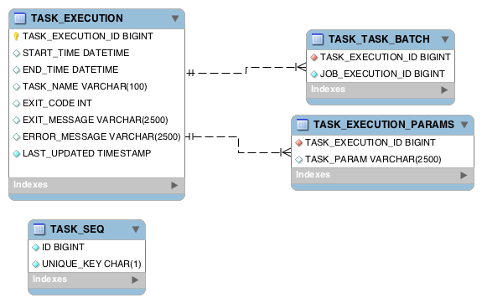
Task repository schema

Slide 11
Integrations with Spring Batch
Associates a Job Execution To The Task In which it was executed
Spring Cloud Task provides the ability to associate the execution of a job (a job execution) with a task’s execution so that one can be traced back to the other.

Slide 12
Spring Cloud Deployer
https://github.com/spring-cloud/spring-cloud-deployer
provides facilities for launching Spring Boot based applications on most cloud infrastructures.

Slide 13
Spring Batch
Version 4
Extract, transform, load

Slide 14
Spring Batch
provides reusable functions
  logging/tracing
  transaction management
  job processing statistics
  job restart, skip
  resource management.
  JSR-352 is the new java specification for batch processing.

Slide 15
Features
@EnableBatchProcessing annotation adds many critical beans that support jobs and saves you a lot of leg work.
  For example a memory-based database (provided by @EnableBatchProcessing), meaning that when it’s done, the data is gone.
Provides a collection builders for itemReaders and ItemWriters implementations that come with the framework.

Slide 16
Batch Code
Define input, processor, and output
Job Configuration
  jobBuilderFactory
  stepBuilderFactory

Slide 17
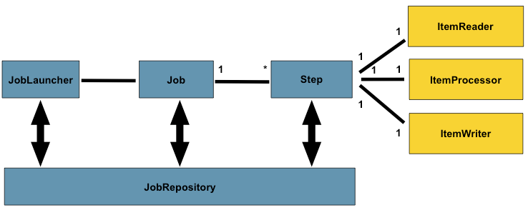
Batch Stereotypes

Slide 18
Job
In Spring Batch, a Job is simply a container for Step instances.
The job configuration contains:
  The simple name of the job.
  Definition and ordering of Step instances.
  Whether or not the job is restartable.

Slide 19
JobInstance
A JobInstance refers to the concept of a logical job run.

Slide 20
Configuring a job
Create a bean that is a job builder.
@Bean
public Job importUserJob(JobCompletionNotificationListener listener) {
return jobBuilderFactory.get("importUserJob")
.incrementer(new RunIdIncrementer())
.listener(listener)
.flow(step1())
.end()
.build();
}

Slide 21
Job
In Spring Batch, a Job is simply a container for Step instances.
The job configuration contains:
  The simple name of the job.
  Definition and ordering of Step instances.
  Whether or not the job is restartable.

Slide 22
Job Instance
A JobInstance refers to the concept of a logical job run.

Slide 23
JobParameters
A JobParameters object holds a set of parameters used to start a batch job

Slide 24
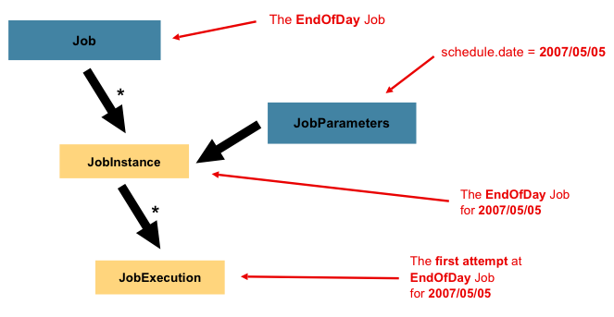
Batch Execution

Slide 25
JobExecution
A JobExecution refers to the technical concept of a single attempt to run a Job.

Slide 26
Stopping a job

Slide 27
Scheduling Jobs

Slide 28
Quartz
Overview

Slide 29
Quartz
Has Four main components:
  Scheduler
  Job
  JobDetail
  Trigger

Slide 30
Quartz Scheduler
A scheduler is obtained from a SchedularFactory.
Serves as a registry of JobDetails (a reference to a Quartz Job) and triggers.
responsible for executing a job when it’s associated trigger fires.
When a trigger fires, telling Quartz to execute a job, a JobDetails object is created to define the individual execution of the job.

Slide 31
Integrate Spring Batch and Quartz
The relationship looks like the following
  Spring Batch <--> Spring QuartzJobBean <--> Quartz Frameworks
  The QuartzJobBean is acts like a bridge between Spring batch and Quartz frameworks.

Slide 32
Quartz API
The key interfaces of the Quartz API are:
  Scheduler - the main API for interacting with the scheduler.
  Job - an interface to be implemented by components that you wish to have executed by the scheduler.
  JobDetail - used to define instances of Jobs.
  Trigger - a component that defines the schedule upon which a given Job will be executed.
  JobBuilder - used to define/build JobDetail instances, which define instances of Jobs.
  TriggerBuilder - used to define/build Trigger instances.

Slide 33
Batch Controller Framework
Schedule Batch Jobs
Invoke Batch Jobs
Monitor Batch Jobs

Slide 34
Products
Zookeeper for configuration management
Kafka for messaging
Spring Batch
Spring Boot
Eureka Server

Slide 35
Apache Zookeeper
Apache Curator - Java/JVM client library for Apache ZooKeeper.
Spring Cloud Feign Integration

Slide 36
Inter-process communication (IPC)
Notifications
request/response
publish/subscribe

Slide 37
IPC Options
HTTP Publish-Subscribe Servers
  Comet
RabbitMQ
WebFlux framework
  Reactive Streams
  https://www.callicoder.com/reactive-rest-apis-spring-webflux-reactive-mongo/

